Slide 1
Abuse Prevention Day
10th September 2011

Slide 2


Slide 3
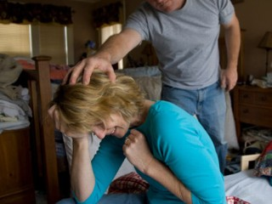
What Is Abuse?
Abuse occurs when one person uses violent or intimidating behaviour to control or dominate the other person, resulting in harm.

Slide 4
Name Types of Abuse

Slide 5
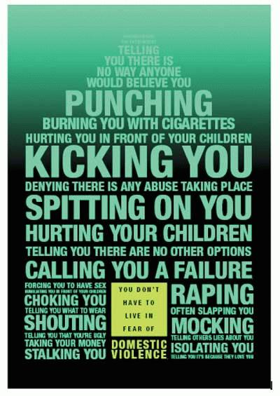
Physical Abuse
Punching, hitting, slapping, shoving, throwing objects, pulling hair, biting, twisting limbs, choking, kicking, strangulation, shooting, stabbing, the infliction of fractures or burns, the use of chemicals, killing.
Depriving a person of basic needs - denial of nutrition, sleep, medical care.

Slide 6
Emotional abuse
Words and behaviours that destroy another person's belief in themselves, and reduces their self-esteem.
Insults about appearances, ability to cope or to be able to succeed on own.
Brainwashing: Victim feels guilty or worthless.
Threats: - to kill the children, pets, the victim or to commit suicide.

Slide 7
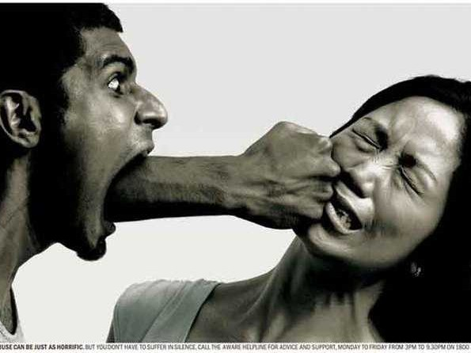
Sticks and stones may break my bones but words DO also hurt me.

Slide 8
Sexual Abuse
This is any sexual act to which an adult does not freely give consent or any sexual act with a child.

Slide 9
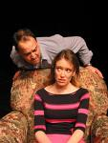
Social Abuse
Delivering verbal abuse in front of other people - put downs, jokes, criticisms about appearance, sexuality, and intelligence. Bullying – texts
Controlling behaviour, interrogations, false accusations.
Isolating a person leading them to cut themselves off from family and friends.

Slide 10
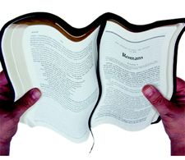
Spiritual Abuse
Telling someone that God hates them; Refusing to let them go to worship
Using religious teaching to justify abuse (e.g. ‘Wives submit to your husband’ which is actually a call to live in harmony and mutual respect Eph 5:22-25)
To compel forgiveness.

Slide 11
God’s Property
Any form of abuse against another person, is an abuse against God’s property and equivalent to abuse against Christ Himself..

Slide 12
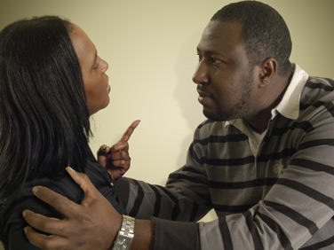
Domestic Violence
“Any incident of threatening behaviour, violence or abuse between a family member, partner or ex-partner.

Slide 13
Facts About Domestic Abuse
1 in 4 women in this country experience DV at some point in their lives.
Every minute police receive a call about domestic abuse.
On average there will have been 35 assaults before a victim calls the police.
An average of 2 women a week are killed by their male partner or ex-partner in England and Wales.
1 in 3 suicide attempts is by a victim of domestic abuse.

Slide 14
Case History
Read case History
Discuss points

Slide 15
Discussion Points
Name types of abuse that took place:
Physical
Emotional
Spiritual
Financial
Social

Slide 16
Discussion Points
2. What were the messages to Beth from her pastor?

Slide 17
It is important to note that when dealing with people who abuse, church ministers need to hold them accountable for their behaviour.
Couple counseling is not appropriate, and can endanger the victim’s safety.

Slide 18
Intervention by Church ministers Should have
3 goals:
      Safety for the victim and children
      Accountability for the abuser
      Restoration of the relationship ( if possible) or mourning over loss

Slide 19
Discussion Points
3. What were the messages to Beth from the Community Services Leader?

Slide 20
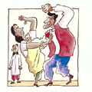
Abuse and Christians
It has not been easy for Christians to admit that abuse exists in their churches.

Slide 21
Religion: Resource or Roadblock?
As a resource, religion encourages women to resist mistreatment,
As a roadblock, its misinterpretations can contribute to the victim’s self blame and suffering, And to the abuser’s rationalisation of his conduct.
A correct reading of Scripture leads to an understanding of the equal dignity of men and women and to relationships based on mutuality and love.

Slide 22
It’s Their Business!
But are we like the 2 that walked on the other side.
Are we ignoring each other? Are we leaving our members bloody and beaten by the side of the road? In some cases, this is EXACTLY the case.
Domestic violence in the SDA church has steadily increased over the years.
Are we more interested in turning the other cheek and neglecting each other because "That's their business" "I'm not taking sides" "They're grown people." "They can work it out."

Slide 23
“The Household of Faith"
The Bible writer Paul refers to the church as “The household of faith” because it should function as an extended family, offering acceptance, understanding and comfort, especially to those who are hurting.

Slide 24
Seventh-day Adventists.....
Must take reports of abuse seriously. To remain indifferent and unresponsive is to condone, perpetuate and potentially extend the abuse.

Slide 25
Discussion Points
4. What were the underlying unspoken messages to Don?

Slide 26
Discussion Points
5. What should the response to Beth have been?

Slide 27
When Women Break the Silence
The first and most important act is to tell them you believe them.
Be patient, listen that means don’t talk.
Never minimise their story.
Let them know that you are there to support them.
Confidentiality to a point.

Slide 28
When Women Break the Silence
Let them know that they are innocent in God’s eyes regarding the abuse.
Understand that forgiveness is a process just like grief.

Slide 29
For Abused Women
You are not alone, and help is available for you.
Talk in confidence to someone you trust.
Set up a plan of action to ensure your safety.

Slide 30
What The Church Can Do To Help
Use sermons to draw attention to violence and abuse.
Describe what abuse is so that women recognize what's happening to them.
Identify violence against women as a sin.
Ask direct questions if you suspect abuse.
Have an action plan in place incase an abused women calls on you for help.
Discuss domestic violence in pre marriage counselling sessions

Slide 31
What Churches Can Do To Help
Include information about domestic violence and local resources in bulletins, newsletters and websites.
Challenging commonly held religious and cultural beliefs that victims and perpetrators may use to justify or cover up domestic violence.
Find a volunteer to receive in depth training.

Slide 32
6. What should the response to Don have been?

Slide 33
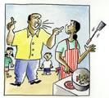
For Men Who Abuse
Recognise that violence against women is a sin that must be repented of on an individual level before reconciliation with God and with the victim can occur.
Be willing to reach out for help.

Slide 34
Discussion Points
7. What is the church’s responsibility to Beth, Don and their daughter?

Slide 35
1. Providing support, counselling and mediation services to victims of domestic violence.
2. Addressing the spiritual questions of victims, seeking to understand the reasons for abuse.
3. Challenging commonly held religious and cultural beliefs that victims and perpetrators may use to justify or cover up domestic violence.

Slide 36
4. Educating church members about how to maintain healthy relationships and about the factors contributing to domestic violence
5. Providing a ministry of reconciliation to perpetrators as changed attitudes and behaviour open new beginnings for them.

Slide 37
Discussion Points
8. How can the church work with community agencies/services to help this family?

Slide 38
A Suggested Charter for our Churches
Will play its part in teaching that domestic violence is a sin that must be repented of on an individual level before reconciliation with God and with the victim can occur
Will live a new model of what it means to be male and female, teaching and preaching it, thereby challenging society and affirming that God is a God of justice, love, mercy and forgiveness
Will appoint an advocate who will use good practice guidelines to support victims of abuse
Will sign up to ”End it now” campaign .
Wellingborough SDA Church:
Accepts that domestic violence is a serious problem which occurs in church families as well as in wider society
Recognises that domestic violence is unacceptable and must be stopped
Undertakes to listen, support and care for those affected by domestic violence
Will keep up to date with the support agencies that are available locally and publicise them.

Slide 39
I GOT FLOWERS TODAY…
I got flowers today.
It wasn’t my birthday or any other special day.
We had our first argument last night, and he said a lot of cruel things that really hurt me.
I know he is sorry and didn’t mean the things he said,
Because he sent me flowers today.

Slide 40
I GOT FLOWERS TODAY…
I got flowers today.
It wasn’t our anniversary or any other special day.
Last night, he threw me into a wall and started to choke me.
It seemed like a nightmare. I couldn’t believe it was real. I woke up this morning sore and bruised all over.
I know he must be sorry, because he sent me flowers today.

Slide 41
I GOT FLOWERS TODAY…
I got flowers today, and it wasn’t Mother’s Day or any other special day.
Last night, he beat me up again. It was much worse than all the other times.
If I leave him, what will I do? How will I take care of my kids?
What about money? I’m afraid of him and scared to leave.
But I know he must be sorry, because he sent me flowers today.

Slide 42
I GOT FLOWERS TODAY…
I got flowers today.
Today was a very special day. It was valentines day and also the day of my funeral.
Last night, he finally killed me. He beat me to death.
If only I had gathered enough courage and strength to leave him,
I would not have gotten flowers today.

Slide 43

THE IMPORTANCE OF
CHURCH DISCIPLINE
“Matthew 18:15-20 teaches that a sinner is to be confronted, reproved and, if they refuse to repent, excluded from the church.
“Acts 5:1-11 illustrates the seriousness of sin within the church, the sensitivity of the Holy Spirit to sin, and the quick judgment of God upon sin.
Notes:
The Importance of Church Discipline
Most churches assume that they will never have a case of abuse and therefore have no plans as to how to take care of the problem. One of the most common ways of dealing with a problem of abuse of power has been to sweep it under the rug. But dealing with the abuser is vitally important. Here are some texts to look at: “Discipline is not optional. It is mandatory in Scripture.”
“Matthew 18:15-20 teaches that a sinner is to be confronted, reproved and, if they refuse to repent, excluded from the church.
“Acts 5:1-11 illustrates the seriousness of sin within the church, the sensitivity of the Holy Spirit to sin, and the quick judgment of God upon sin.
http://www.cotubic.org/ministers/Restoration/introduction.html. Accessed 2/20/2008.
“1 Corinthians 5:1-5 teaches that the church's response to persistent, unrepentant sin is to grieve, deliberate, judge the sin, and exclude the unrepentant member.
“1 Thessalonians 5:14 commands us to warn the disobedient and the disorderly.
“2 Thessalonians 3:6-15 teaches us to warn the undisciplined brother and withdraw from him.
“1 Timothy 5:20 tells us to rebuke persistent sin publicly.

